Slide 1

Microwave Popcorn
STAT571B Project
Spring 2016
Jimmy Thornton & Ken Youens-Clark

Slide 2
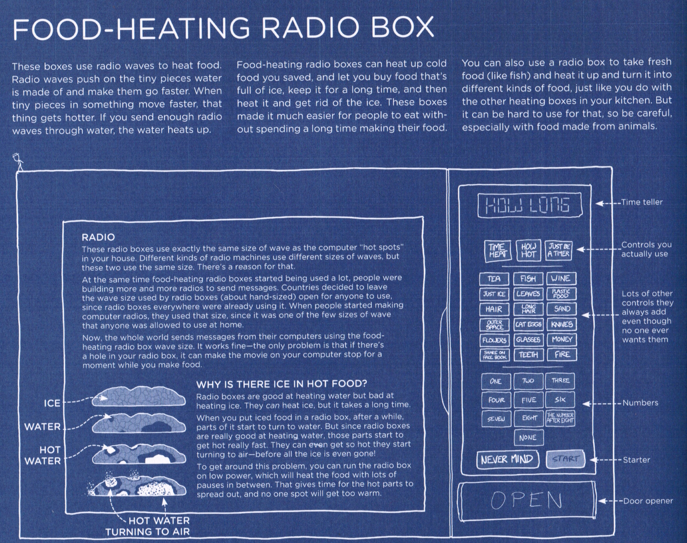
Thing Explainer, Randall Munroe

Slide 3
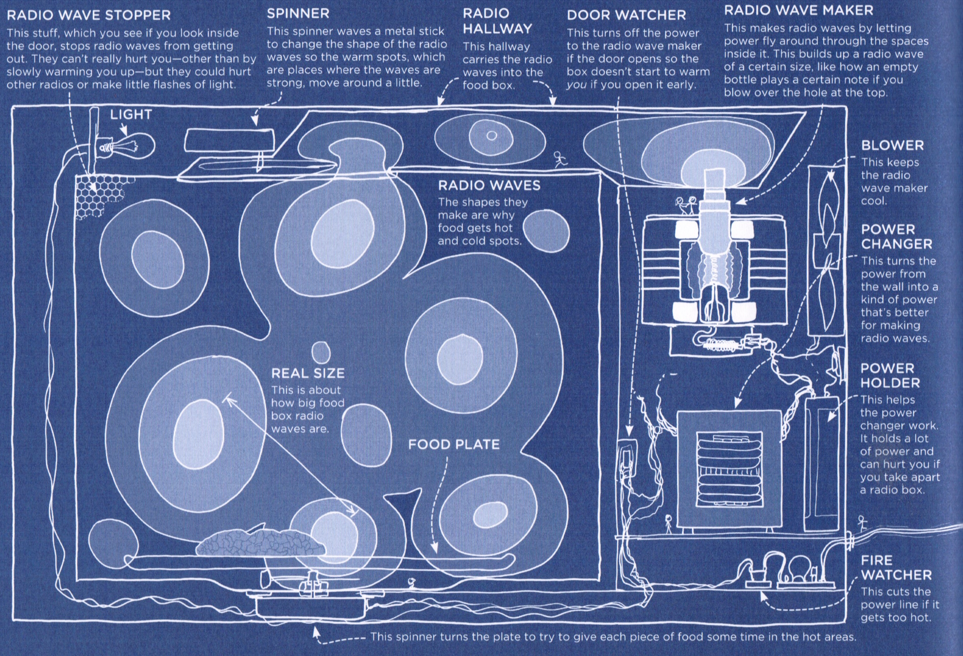

Slide 4
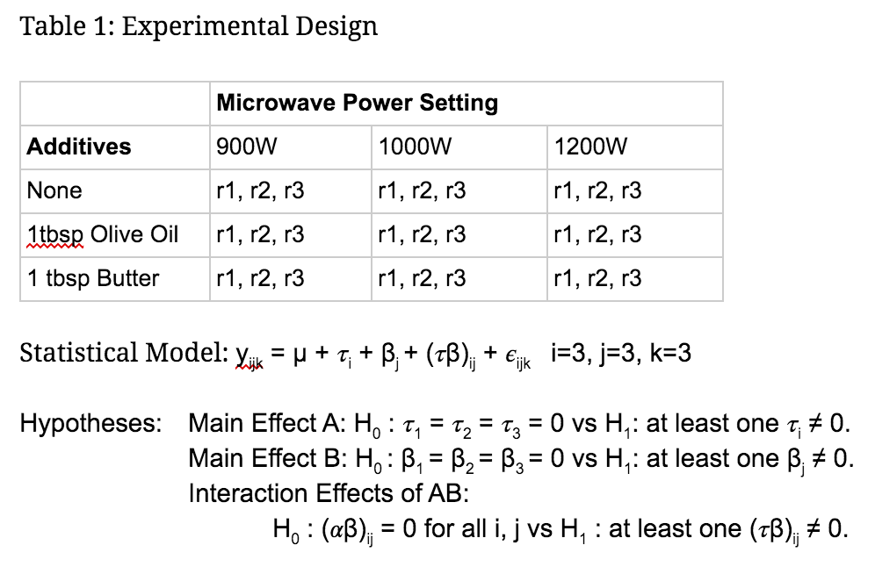
Design
2-factor fixed effect factorial

Slide 5
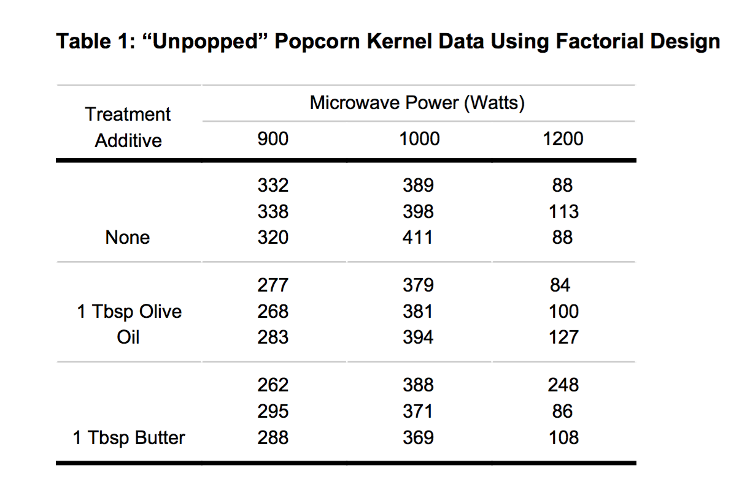
Data

Slide 6
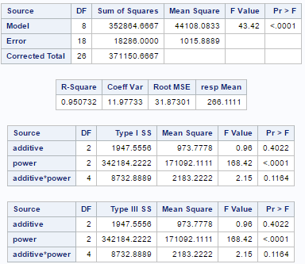
ANOVA

Slide 7
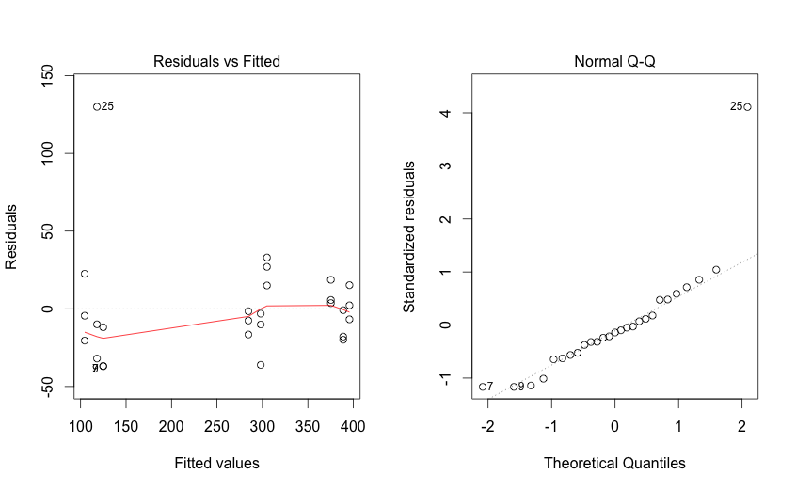
Normality

Slide 8
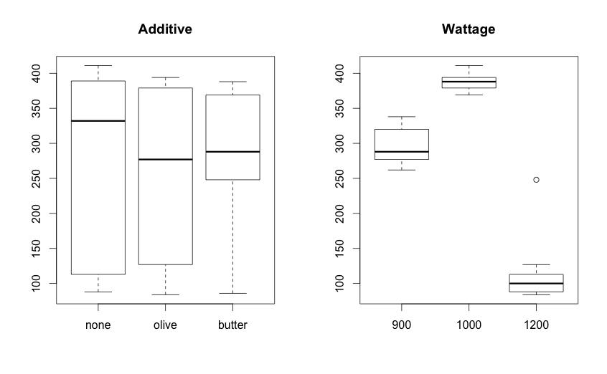

Slide 9
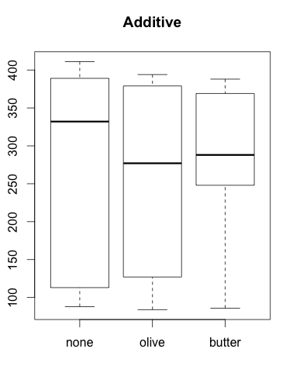
Additives
Expectation was that no additive would have more unpopped kernels, but this was wrong
No significant variation

Slide 10
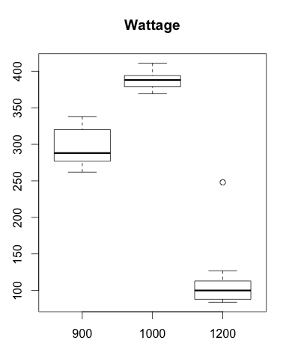
Microwaves/Power Factor
1200W: ~1 yo, Panasonic, best (Ken’s)
1000W: ~1 yo, worse (Jimmy’s sister)
900W: ~2 yo, Westgate, middle (Jimmy’s)
All ovens used a turntable
Significant variation

Slide 11
Potential Errors
Differences in ¼ cup ~ 400 kernels
Do older ovens work properly/can we trust wattage?

Slide 12
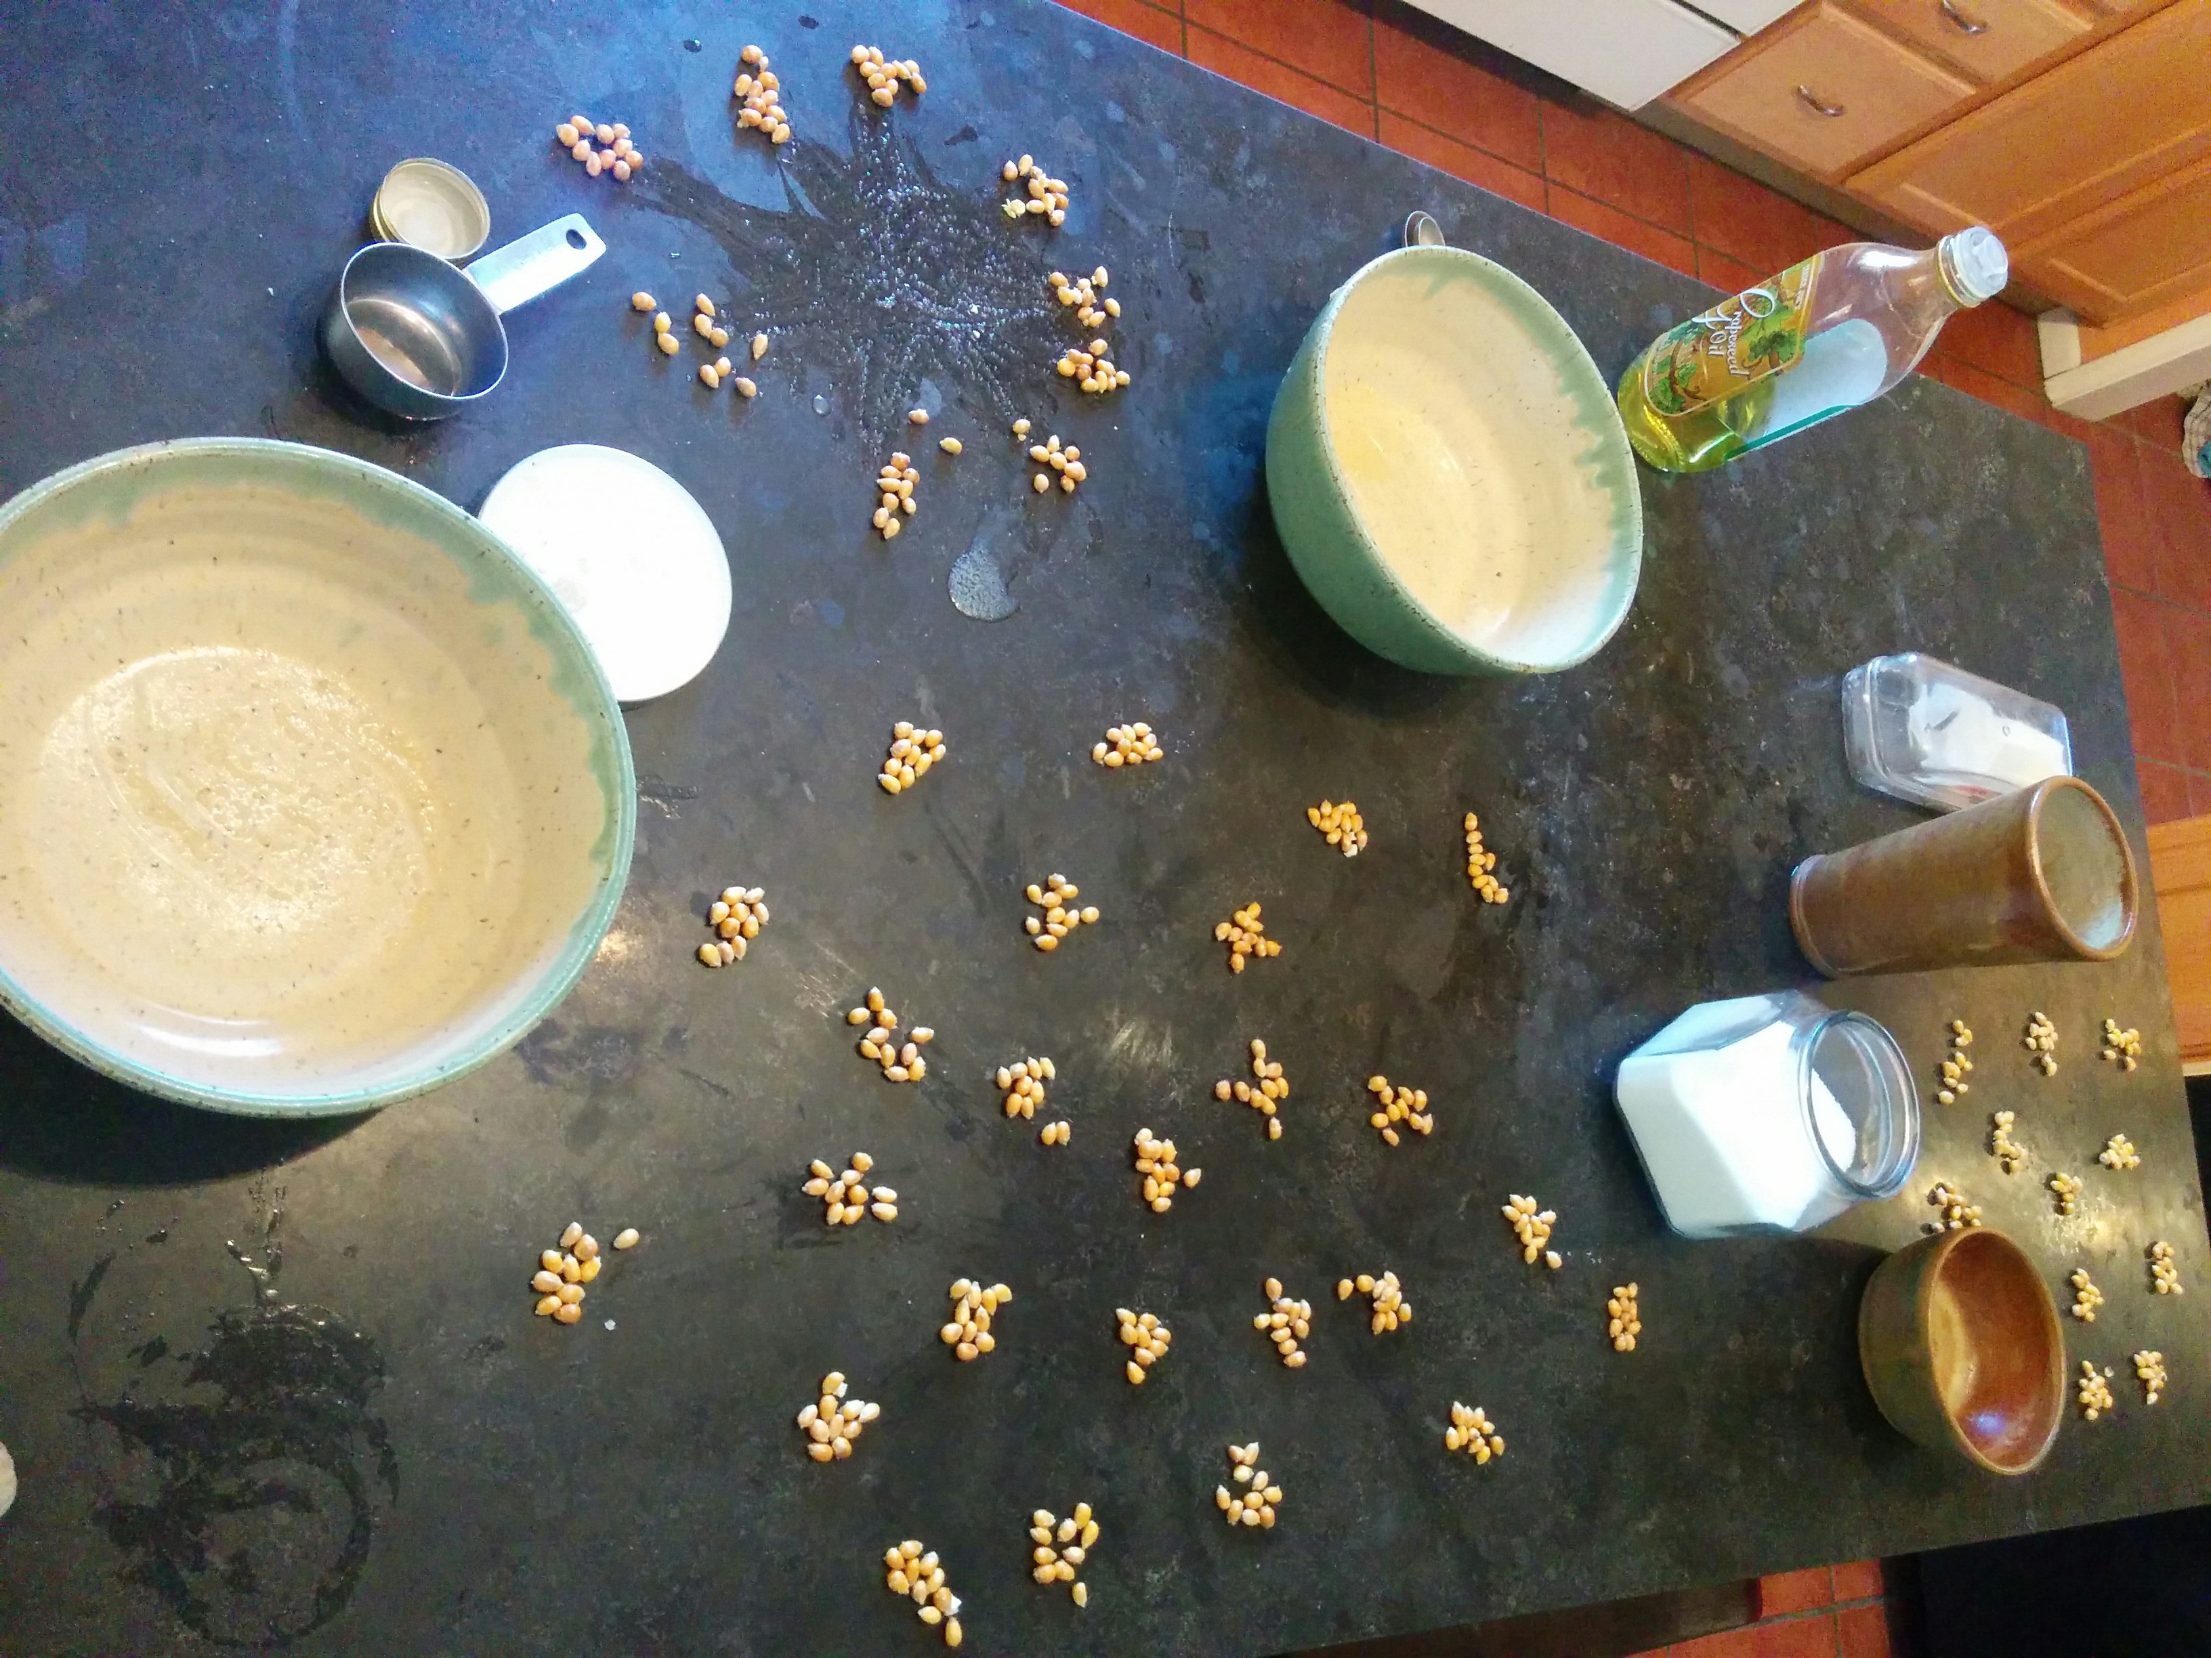
Counting

Slide 13
Calculations

Slide 14
Conclusions
Fat didn’t make a difference (not expected)
MOAR POWR == MOAR KORN (expected)
Extremely large differences in microwaves

Slide 15
Recommendations (The Best Recipe)
¼ cup kernels
paper bag
1 tbsp fat for flavor* (optional), salt
~1.5 minutes on high (until popping stops)
* be careful not to burn butter

